Slide 1
Biocompatibility Survey
Michael DeSalvio, Kevin Ip, John Chi, Khine Win, Michael Nguyen

Slide 2
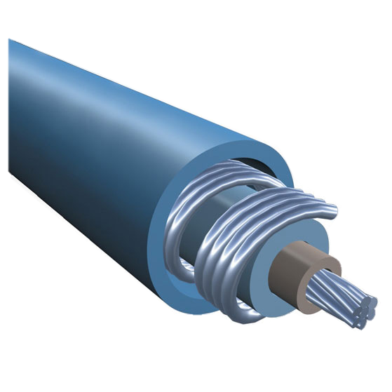
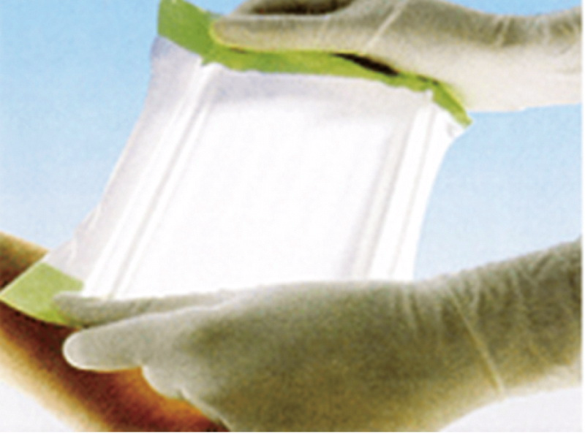
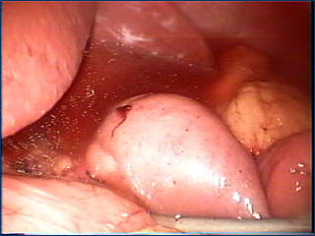
Polyurethane
Properties
Cheap
Durable
Strong
High stress and strain (More tear-resistant than rubber)
Uses
Tubing: catheters, dialysis, sutures, artificial heart valves
Temporary implants: gastric bubbles
Medical bedding (foam)
Surgical drapes
Wound dressing (hydrogels)
Polyurethane implants (non-US)
Condoms
Electrical Insulation

Slide 3
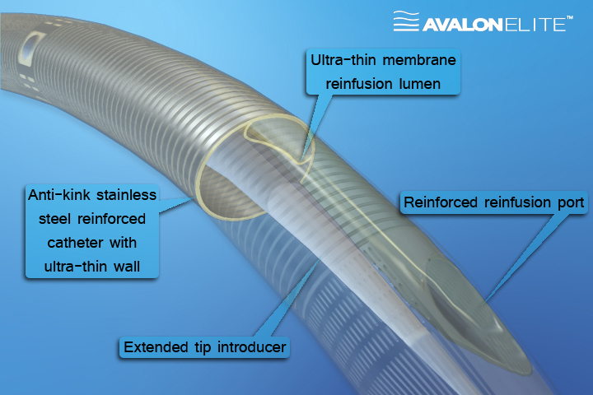
Polyurethane Catheter

Slide 4
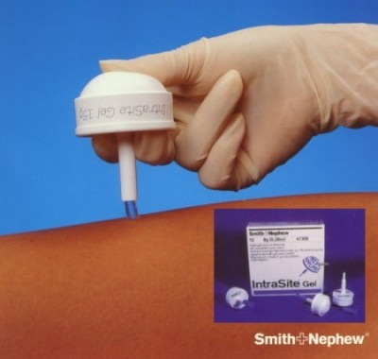
Hydrogels
Biocompatible gel
Provides a moist environment to promote healing
Promotes absorption and debriding of necrotic tissue
Polymer based sheet to cover wounds and deliver drugs via a capsule design
Reduce appearance of scars

Slide 5
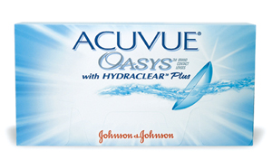
Hydrogel Contact
Traditional contacts are not permeable to O₂
Water inside the contact transfers O₂ from the outside to the eye
Silicon hydrogel contacts are permeable to O₂
Up to 5x more O₂ can pass through
Can be worn for up to 30 days w/o removal

Slide 6
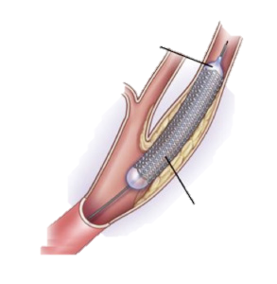
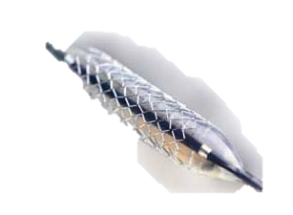
Stainless Steel
Inflated Balloon
Properties
Corrosion- and Heat- Resistant
Durable and easily sterilized
Inexpensive
Easily manipulated to desired shape
Inert, nice finish
Uses
Implants (crowns, joints)
Medical Instrument, (Scalpel, needles, )
Bedpans, Trays, Carts..
Tubing, cables
Bone Plates, Screw, Rods
Expanded Stent

